Slide 1

neuefische GmbH
hh-analytics-24-2
Capstone Pitch
CAPSTONE PITCH:
MVP: Dynamic visualisation of development of ecosystem diversity over time
Goal: Show a trend of ecological parameters over time
Validation: Renaturation efforts in e.g. Great Green Wall Initiative (Africa), Chinese Loess Plateau Rehabilitation, The Netherlands’ Marker Wadden
Noah Kürtös
11.10.2024

Slide 2
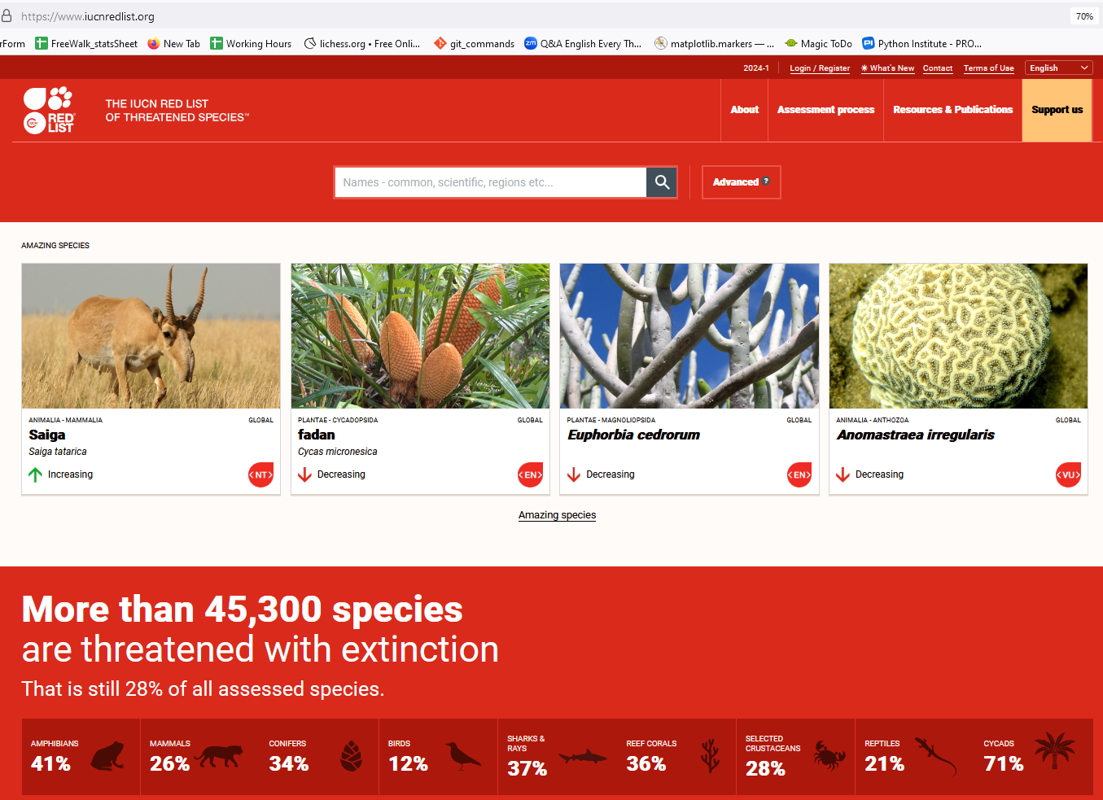
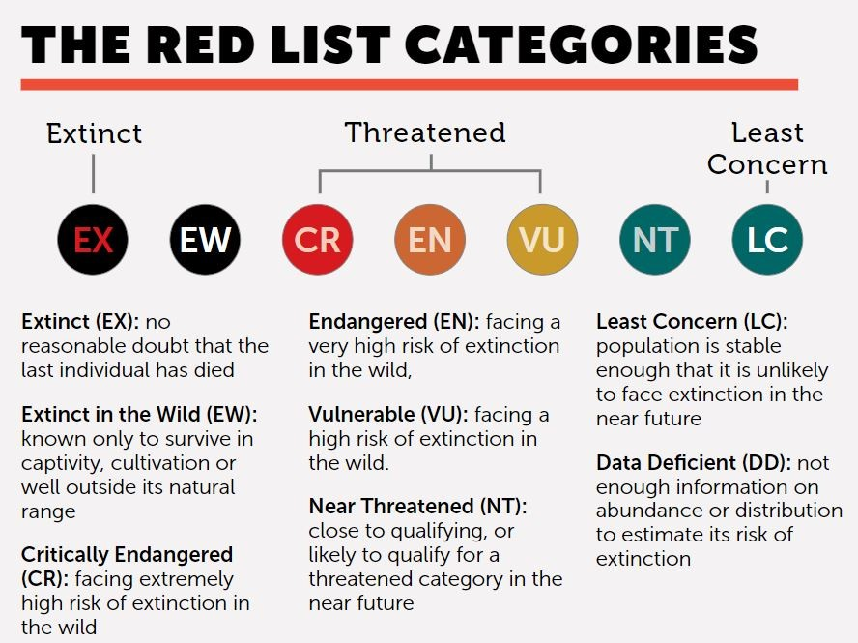
neuefische GmbH
hh-analytics-24-2
Capstone Pitch
Background:
Noah Kürtös
11.10.2024

Slide 3
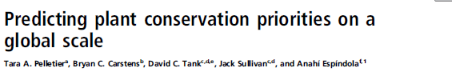
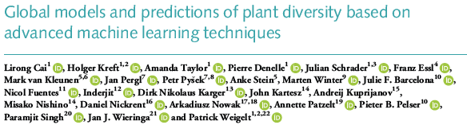
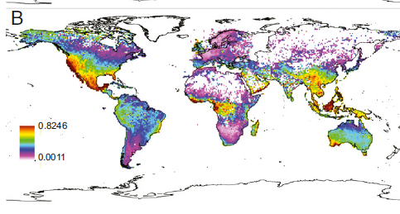
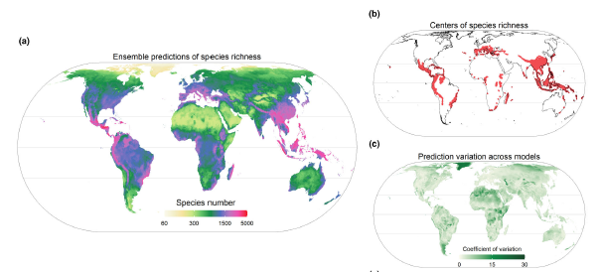
neuefische GmbH
hh-analytics-24-2
Capstone Pitch
Background:
Noah Kürtös
11.10.2024

Slide 4
neuefische GmbH
hh-analytics-24-2
Capstone Pitch
Research question:
“Is the relative extinction rate between ecosystems comparable?”
Noah Kürtös
11.10.2024

Slide 5
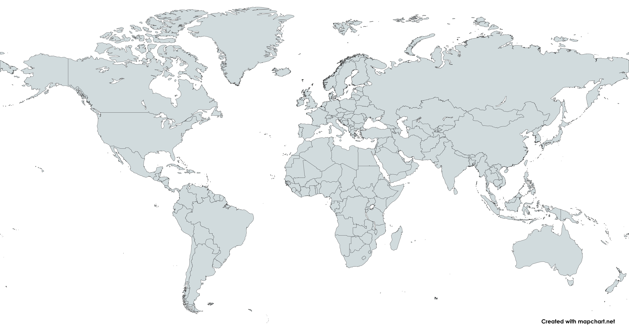
neuefische GmbH
hh-analytics-24-2
Capstone Pitch
Minimum viable Product:
Automatically fetching species data from IUCN red list
Fetching climate data from NOAA
Determine ecosystem similarity
Showing relative ecosystem loss (endangered species / total predicted species)
Noah Kürtös
11.10.2024

